Slide 1
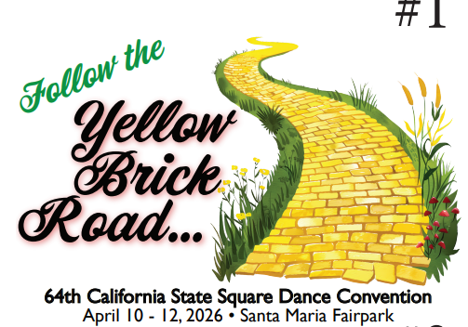
64th California State Square Dance Convention www.squaredance.org/convention/2026/

Slide 2
What, where, when, who, and why…
64th California State Square Dance Convention
April 9-12, 2026
Santa Maria Fairpark
Featured Callers and Cuers From Alabama, Texas, Oklahoma, California, Oregon
Come to Dance, Stay to Play

Slide 3
What?

Slide 4
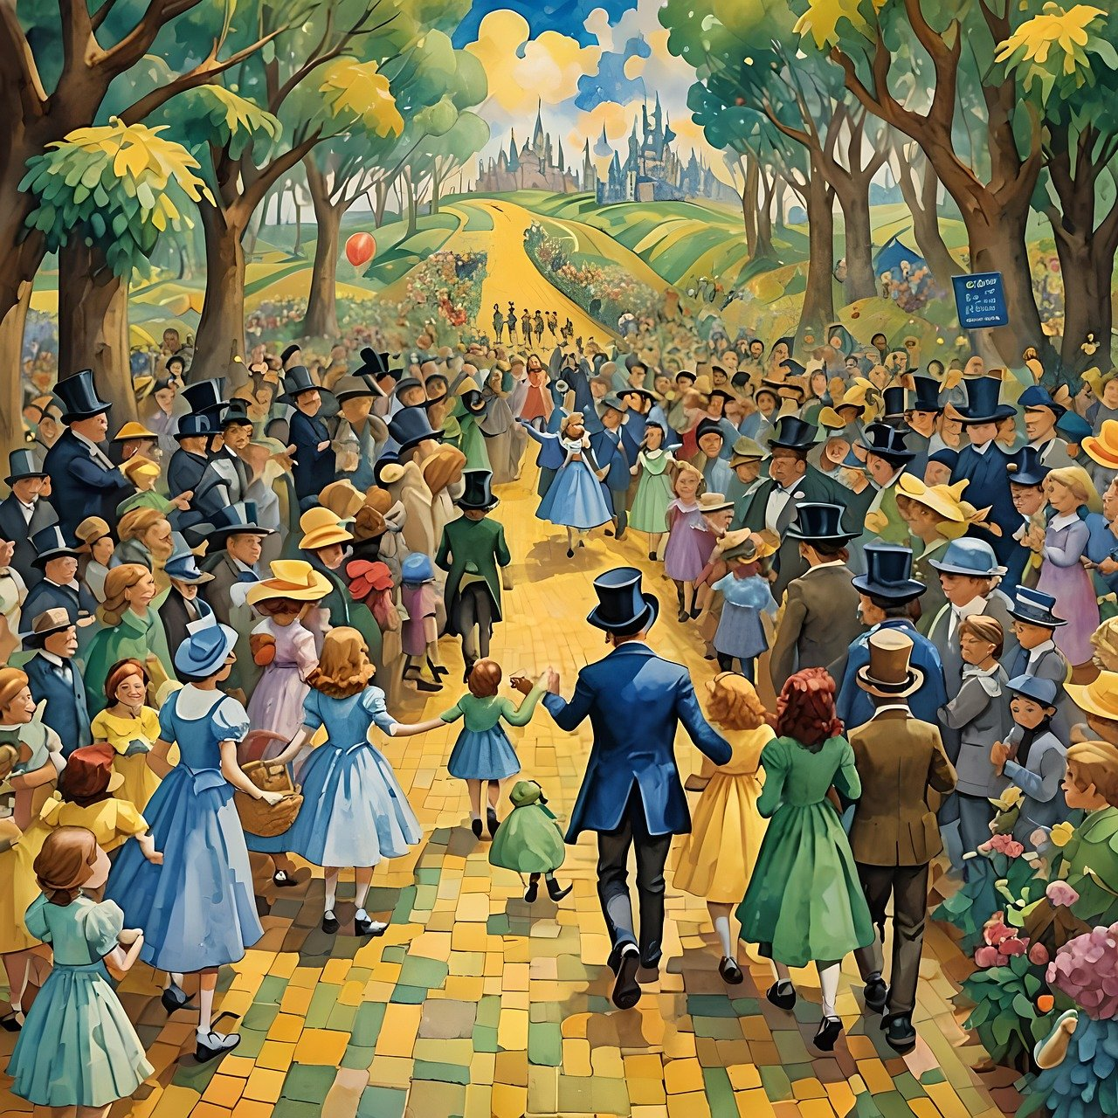
64th California State Square Dance Convention
Dancing Friday afternoon & evening, all day Saturday, Sunday morning
Squares: SSD to Advanced
Rounds: Phases 2 to 5
Specialty Dancing: Workshops, Hex
Thursday Trail’s End Dance

Slide 5
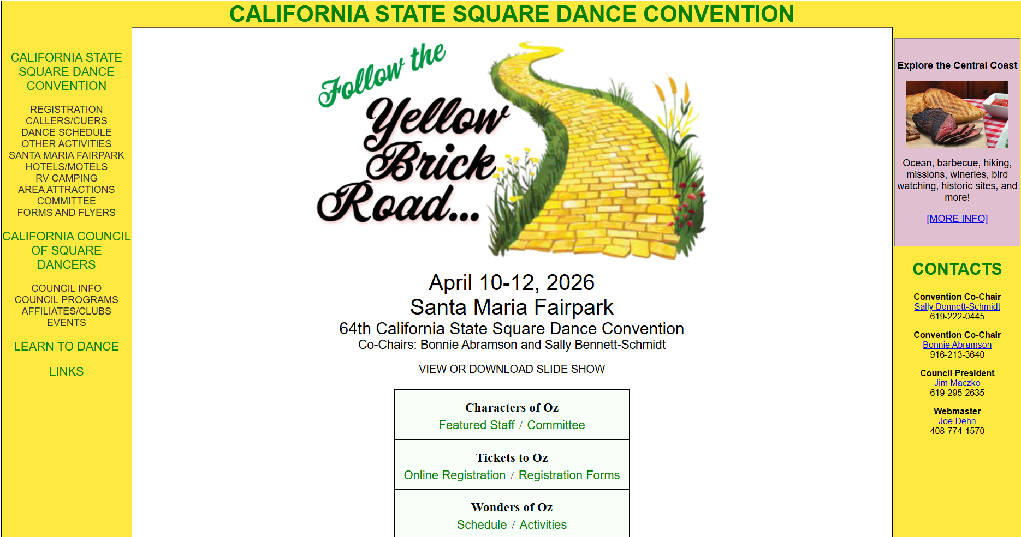
www.squaredance.org/convention/2026/

Slide 6
When

Slide 7
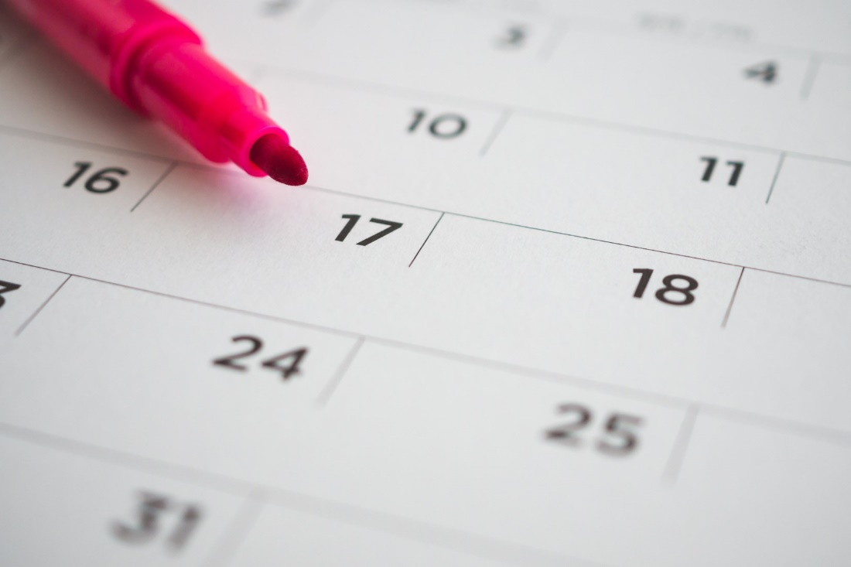
April 2026
April 9: Trail’s End Dance
April 10-12: Convention Activities

Slide 8

Register Early – Tell Your Friends!
Early Bird Registration
$65 through May 31, 2025
Advanced Registration
$75 from June 1, 2025 through March 28, 2026
Door Registration
$85 beginning March 29, 2026
www.squaredance.org/convention/2026/

Slide 9

Where

Slide 10
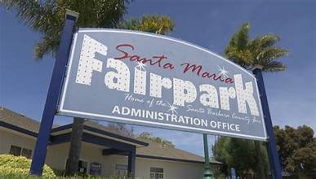
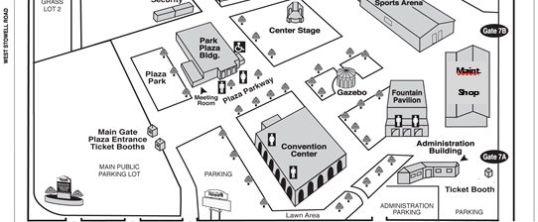
Follow the Yellow Brick Road to…
Santa Maria Fairpark
937 S. Thornburg Street
Santa Maria, CA 93458
3 Halls
Kansas Homestead (Fountain Pavilion)
Munchkinland (Park Plaza Building)
Land of Oz (Convention Center)

Slide 11
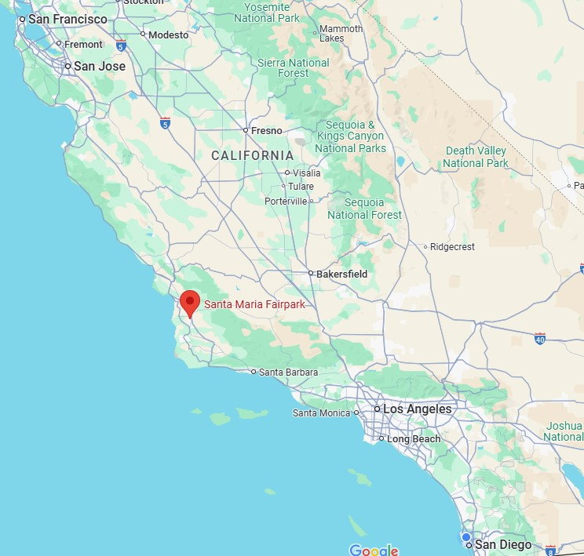
Where is it, again?
Central California Coast
How Central?
San Diego 280 miles
Los Angeles 160 miles
Riverside 210 miles
Fresno 170 miles
San Francisco 270 miles
Sacramento 320 miles

Slide 12
Who?

Slide 13
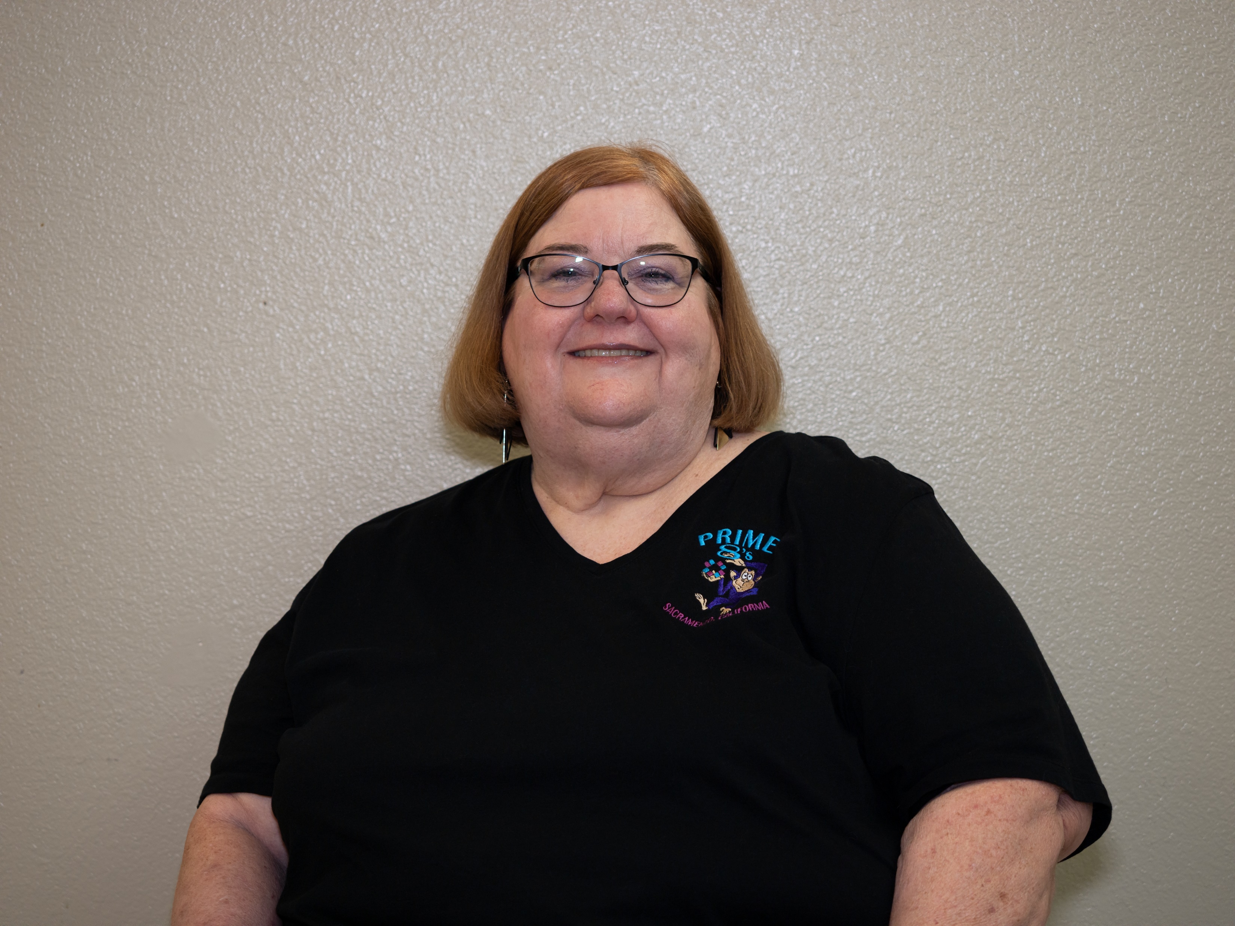
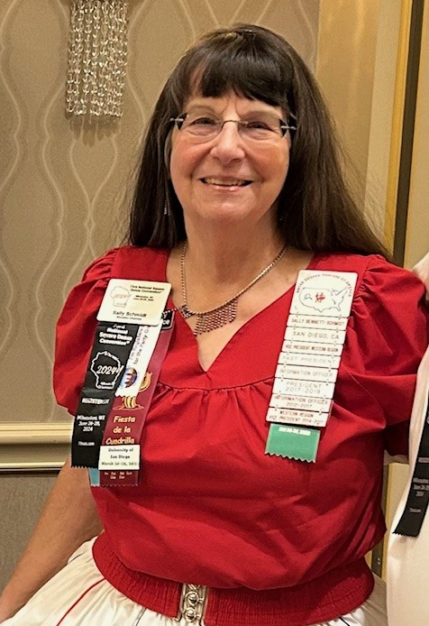
General Chairmen
Bonnie Abramson
Convention Chair / Co-Chair, 2008 and 2023 State Conventions
Festival Chair and Committee Member, ASDSC Harvest Hoedown
Sally Bennett-Schmidt
Convention Co-Chair (with LPaul Schmidt), 2011 CA State Convention & 2022 USA West Convention
Festival Chair and Committee Member, San Diego Fiesta de la Cuadrilla

Slide 14

The Wizards of Dance: Featured Callers
Vernon Jones, Cowboy Wizard from Texas
Jet Roberts, Flying Wizard from Alabama
Charlie Robertson, Serenading Wizard from Oklahoma
Andy Allemao, Dancing Wizard from California
Lawrence Johnstone, Bashful Wizard from California [Trails End Dance]
Scott Pearce, Santa Wizard from California [Trail End Dance]

Slide 15
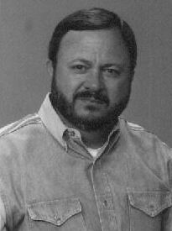
Vernon Jones, Cowboy Wizard
Featured caller throughout the convention
Caller Clinic instructor – CALLERLAB accredited caller coach
Square dancer since Junior High School, caller since 1978
Elected to Texas Callers Hall of Fame
Hails from Springtown (North Texas)

Slide 16
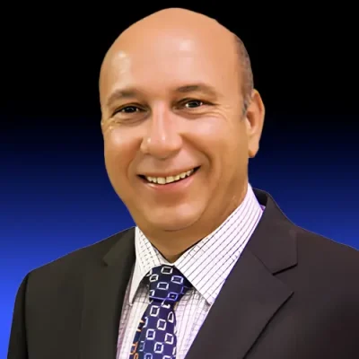
Jet Roberts, Flying Wizard
Featured caller throughout the convention
Started calling in 1971 at the age of 8!
Has called throughout the US and in more than 10 other countries
Known for his smooth and interesting choreography
Hails from Owens Cross Roads, Alabama

Slide 17
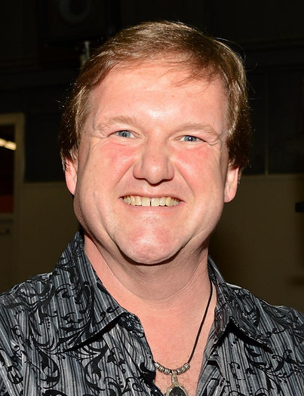
Charlie Robertson, Serenading Wizard
Featured caller throughout the convention
Started calling at the age of 12
Has traveled the world as a caller for the past 40 years
Created and called the first true square dance “rap” song
Now an Oklahoma boy (after many years in California) – living in Sulphur, OK

Slide 18
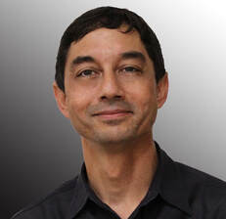
Andy Allemao, Dancing Wizard
Featured caller throughout the convention
Reluctantly attended his first square dance class in 1999 with his wife; both were instantly hooked.
Attended a local caller school in 2003 and quickly grew into a talented caller
Specialty calling including hex dancing
From San Diego, CA – caller/teacher for 3 ½ weekly clubs

Slide 19
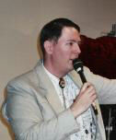
Lawrence Johnstone, Bashful Wizard
Trails End dance caller + Saturday morning session
Started dancing in 1978 and calling in 1994
If it weren’t for square dancing, he literally wouldn’t be here – his parents met square dancing!
Lives in Ukiah, California, and calls for three clubs on a regular basis

Slide 20
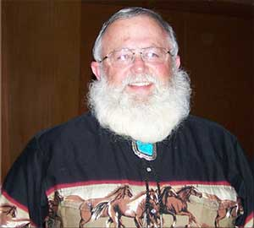
Scott Pearce, Santa Wizard
Advanced star tips at the Trails End dance
Sound Engineer for the convention
Received CALLERLAB half-century award for 50 years of calling
Lives in Folsom, California

Slide 21

The Witches of Dance: Featured Cuers
Sharon & Casey Parker, the Good Witch from California
Rikki Lobato, the Smiling Witch from Oregon

Slide 22
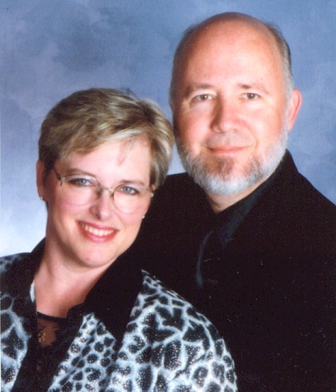
Sharon the Good Witch & Casey Parker,
Featured cuers throughout the convention including Saturday round dance teaches
Met at a beginners square dance hoedown in 1971; Sharon began cueing in 1975 while Casey started calling at the same time.
Featured Round Dance Instructors across the US, including State, National and ROUNDALAB Conventions.
Served on Board of Directors of ROUNDALAB
Hail from Manteca, California

Slide 23
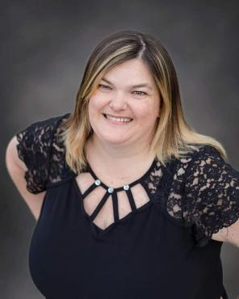
Rikki Lobato, the Smiling Witch
Trails End dance cuer + cueing in the dance halls
Started cueing and teaching in 2017 with the support of wonderful mentors and friends
Member of ROUNDALAB, Oregon Round Dance Teachers Association, and more.
Lives in Grants Pass in Southern Oregon

Slide 24
Where Do I Stay?

Slide 25
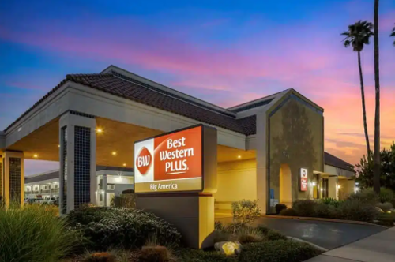
Convention Hotels (1)
Best Western Plus Big America
1725 N.Broadway
Santa Maria, CA 93454
1 King or 2 Queen Beds $105
Mini-Suite $110
(plus taxes)
Reservation deadline 3/21/2026
Call 805-922-5200 Reference Square Dance Convention Group

Slide 26
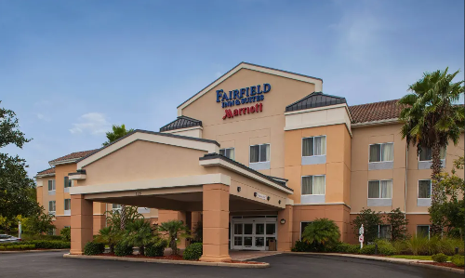
Convention Hotels (2)
Fairfield Inn & Suites by Marriott
2061 Roemer Court
Santa Maria, CA 93454
Thursday & Sunday: $119
Friday & Saturday: $159
(plus taxes)
Reservation deadline 3/9/2026
Call 805-925-8500 Online link coming soon

Slide 27
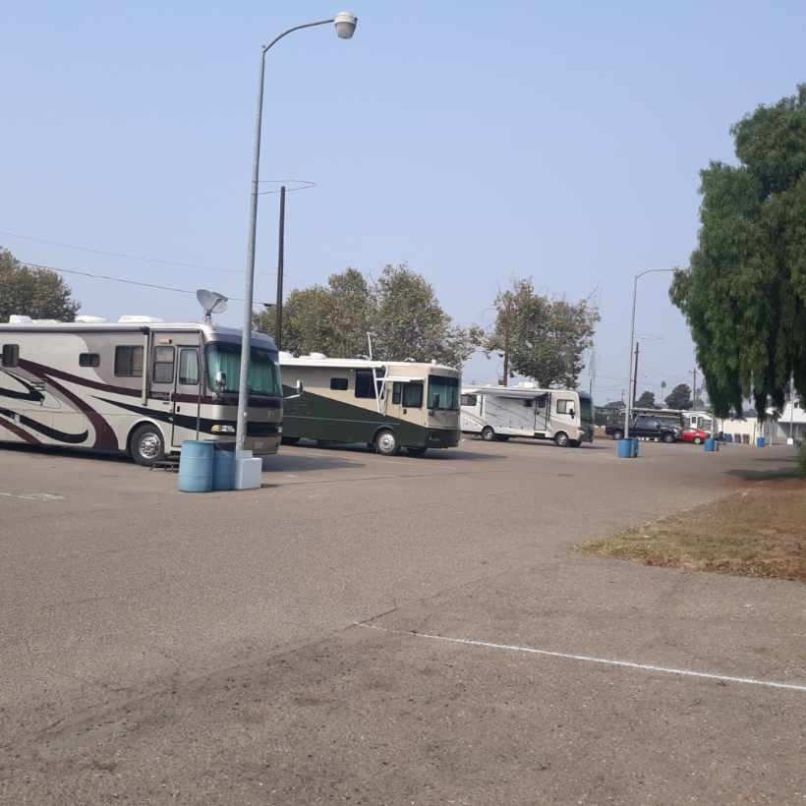
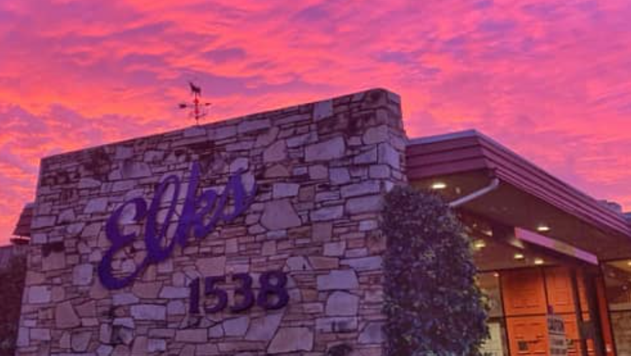
RV Camping in Santa Maria
Santa Maria Fairpark (onsite)
Reservations open October 8, 2025
Link will be posted on website
Santa Maria Elks Lodge (2.6 miles)
1309 North Bradley Road, Santa Maria
(805) 922-1538
Lodge@elks1538.org

Slide 28
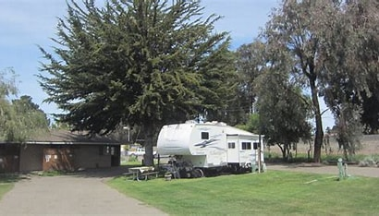
Other RV Camping in the Area
Pismo Sands RV Park (18.8 miles)
pismosandsrv.com/
Pacific Dunes Ranch RV Resort (19.5 miles)
thousandtrails.com/california/pacific-dunes-ranch-rv-resort/
Pismo State Beach Oceano Campground (20.1 miles)
www.parks.ca.gov/?page_id=595
Coastal Dunes RV Park (21.9 miles)
slocountyparks.com/camp/coastal-dunes/

Slide 29
There’s More!

Slide 30

Special Events
Thursday evening Trails End Dance
Saturday evening dinner: Santa Maria Barbecue
Friday and Saturday evening Exhibitions by the Heritage Dancers

Slide 31
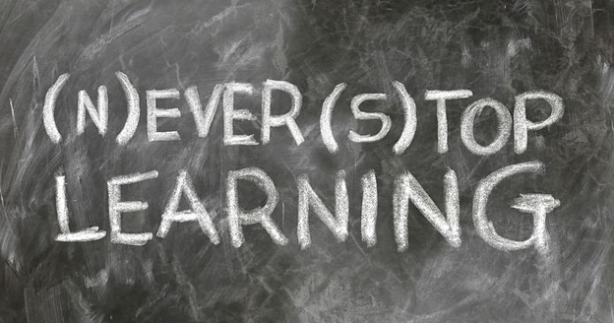
Education
Friday Caller Clinic
Vernon Jones, instructor
CALLERLAB accredited caller coach
Saturday Education Session
Heritage Dancers on the History of Square Dancing in America

Slide 32


Vendors
Do some shopping for yourself, family, or friends!
Current vendors:
Signs by Scott (badges, dangles, more)

Slide 33
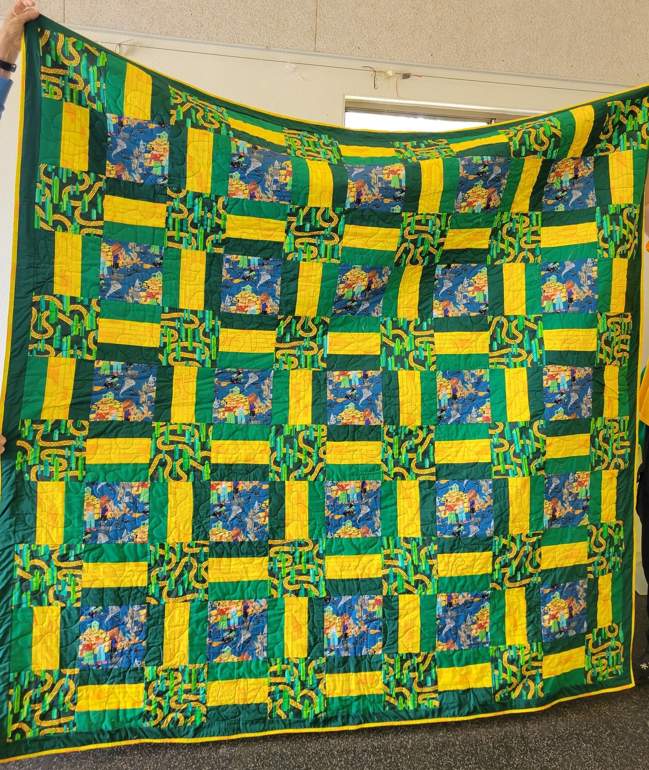
Opportunity Drawing
Handmade Wizard of Oz Theme Quilt (85” x 87”)
Made by Carol Windham from San Diego
Other hand-crafted quilted items such as wall hangings and table runners

Slide 34


Silent Auction
Baskets and items donated by associations, clubs, and dancers
Auction opens Friday afternoon and closes Saturday evening
DONATIONS ARE WELCOME!

Slide 35

Sewing Corner
Patterns to trace
Sewing hints
Minor mending
Freebies (e.g., fabric scraps, trim, etc.)

Slide 36
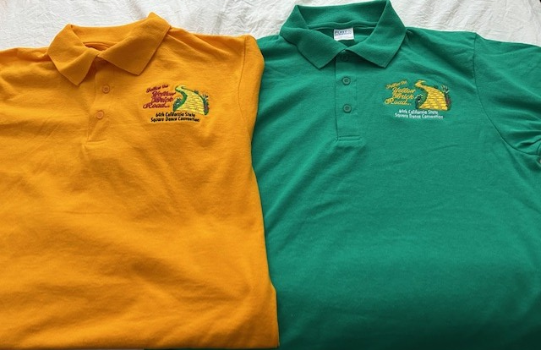
Ways & Means
Convention Polo Shirts
Sizes XS to 2XX
Kelly Green or Gold
Order online or download an order form from the website

Slide 37
What Else?
It’s more than just a dance!

Slide 38
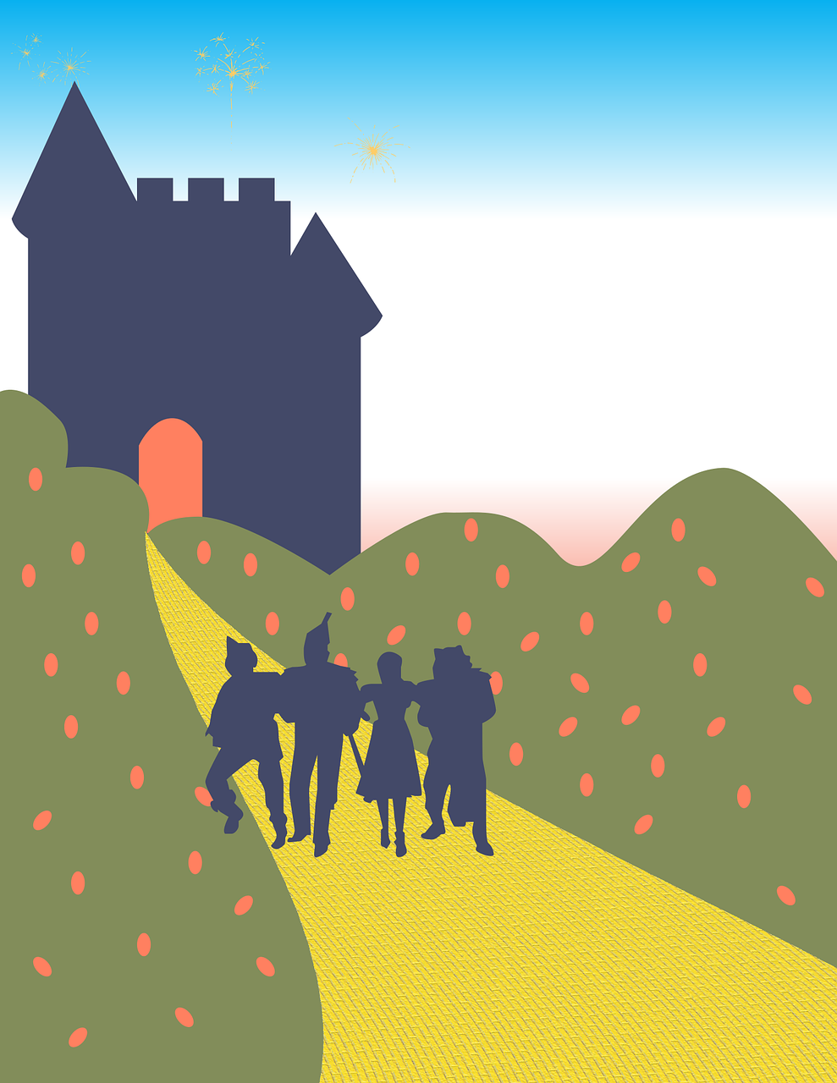
Before or After the Convention, Follow the Yellow Brick Road on to…
Santa Maria is the heart of:
Santa Maria-Style Barbecue!
Wine and whiskey country
Hiking
Beaches
Historic Sites
Landmark attractions

Slide 39
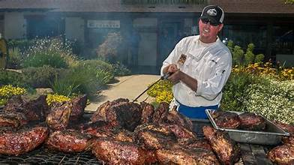
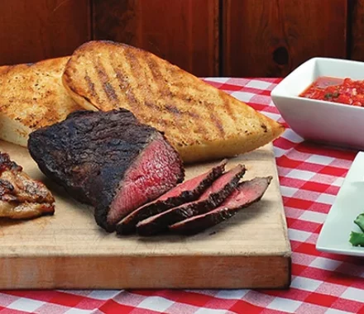
Famous Santa Maria Barbecue
Come hungry and experience fresh, delicious food steeped in tradition dating back 150 years. We have a style all our own, and you have to taste it to believe it.
8 nearby restaurants specializing in Santa Maria-style Barbecue
Santa Maria Style Barbecue at home cookbook
https://santamariavalley.com/barbecue/

Slide 40
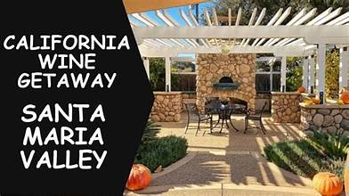
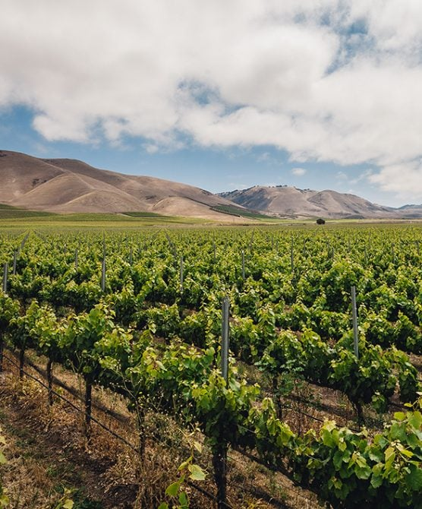
Heart of the Central Coast Wine Country
30+ Wineries & Tasting Rooms
Foxen Canyon Wine Trail
16 wineries featuring world-class wines
Santa Maria Wine Trolley
Let someone else drive so you can visit and taste!
https://santamariavalley.com/wine-country/

Slide 41

What’s Brewing?
Breweries and Taprooms
Tucked away along the Central Coast are some of California’s best microbreweries and taprooms—serving up ice-cold craft beers where everyone is family and "another round" is a given.
Distilleries and Cideries
18 Distilleries
6 Cideries
https://santamariavalley.com/things-to-do/food-drink/breweries-and-taprooms/
https://highway1roadtrip.com/things-to-do/distilleries-of-highway-1/

Slide 42
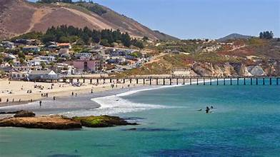
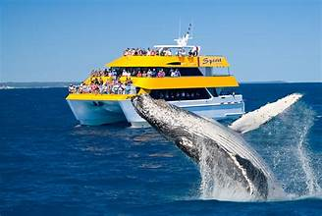
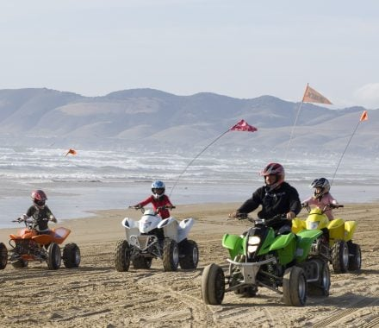
Head to the Shores!
15 Beaches within 30 Miles of Santa Maria including:
Avila City Beach
Pismo Beach
Oceano Dunes
Point Sal Beach
Morro Bay
Swimming, Boat Tours, Whale Watching, Dune Buggies, and more…
https://santamariavalley.com/things-to-do/outdoor-recreation/beaches/

Slide 43
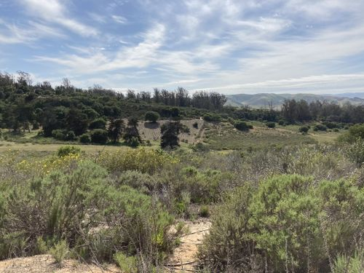
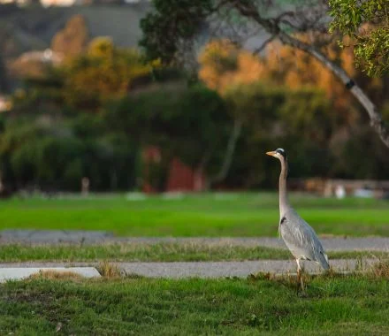
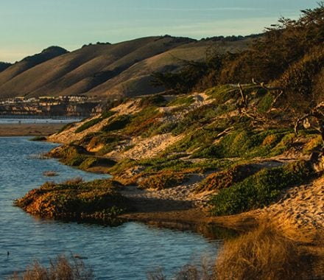
More of the Great Outdoors
It’s always hiking season
24 scenic trails within 30 miles
Bird-watching
From beaches and estuaries to parks and mountain trails
https://santamariavalley.com/things-to-do/outdoor-recreation/

Slide 44
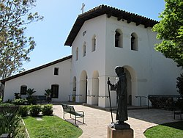
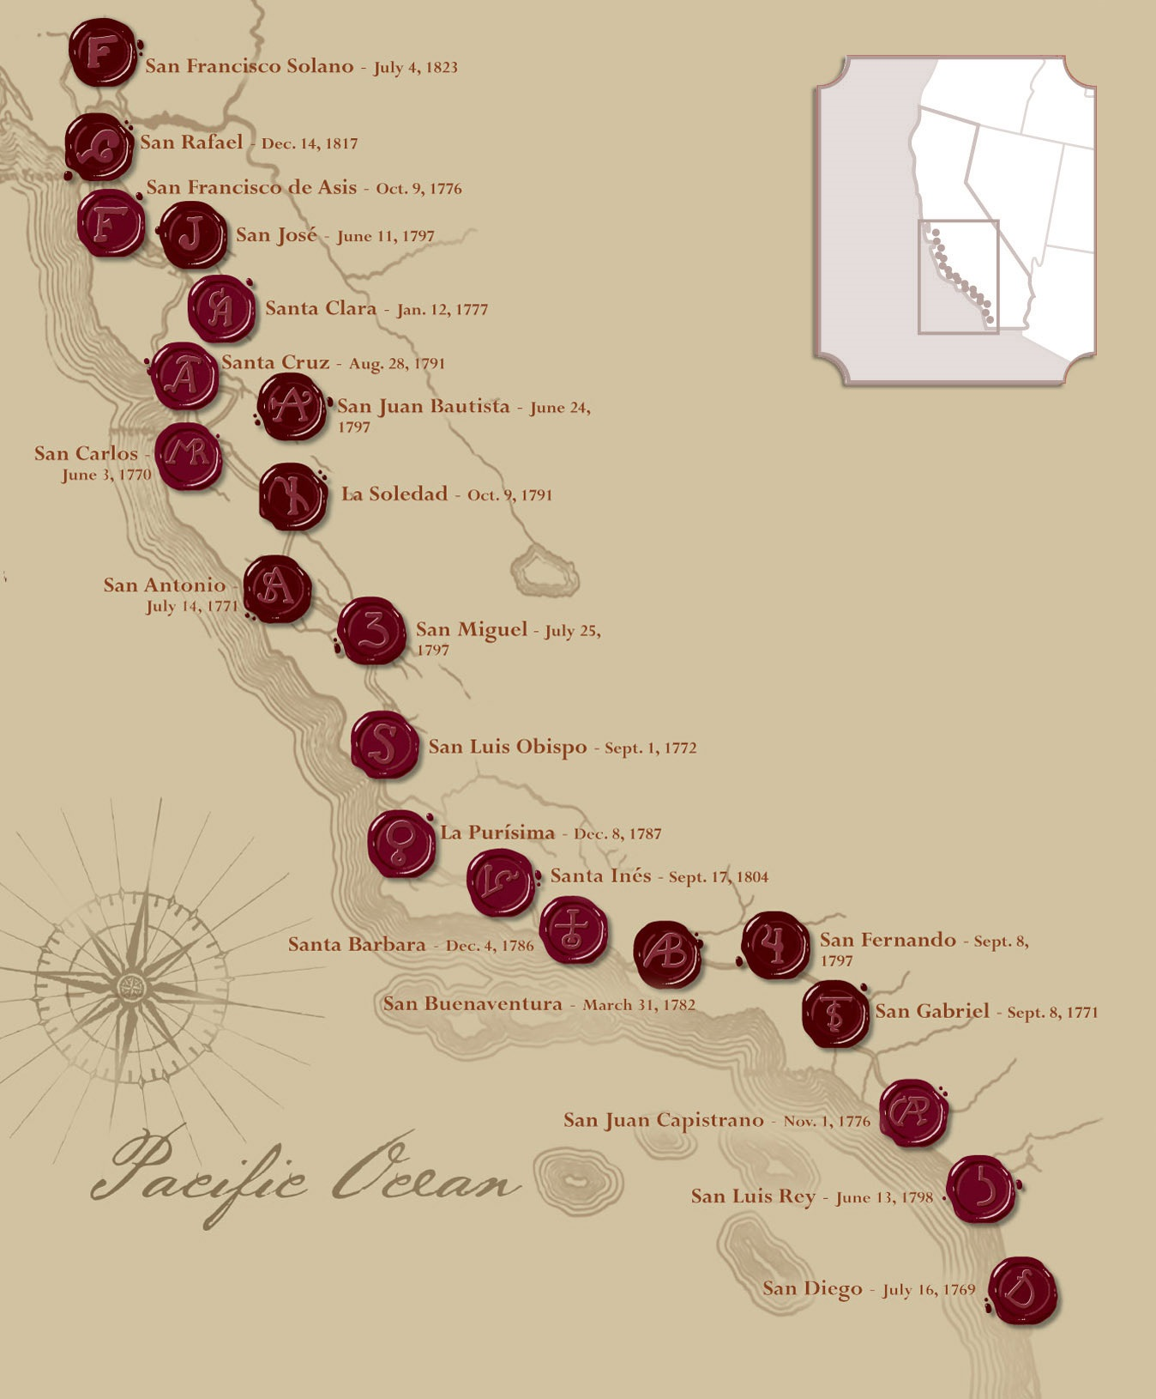
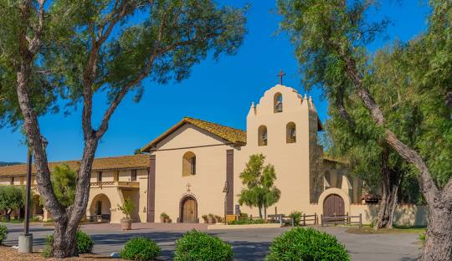
California Missions
Follow the Mission Trail
San Miguel (67 miles north)
San Luis Obispo (31 miles north)
La Purisima (26 miles south)
Santa Inez (36 miles south)
Santa Barbara (62 miles south)

Slide 45
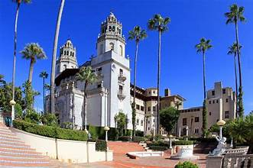
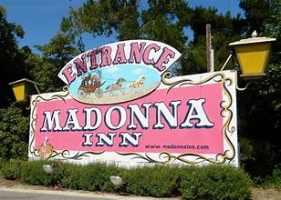
Central Coast Landmarks
Hearst Castle (70 miles north)
Open daily for tours
https://hearstcastle.org/
Madonna Inn (30 miles north)
Eat, tour, stay
https://www.madonnainn.com/
Solvang (35 miles south)
Slice of Danish culture!
https://solvangusa.com/

Slide 46
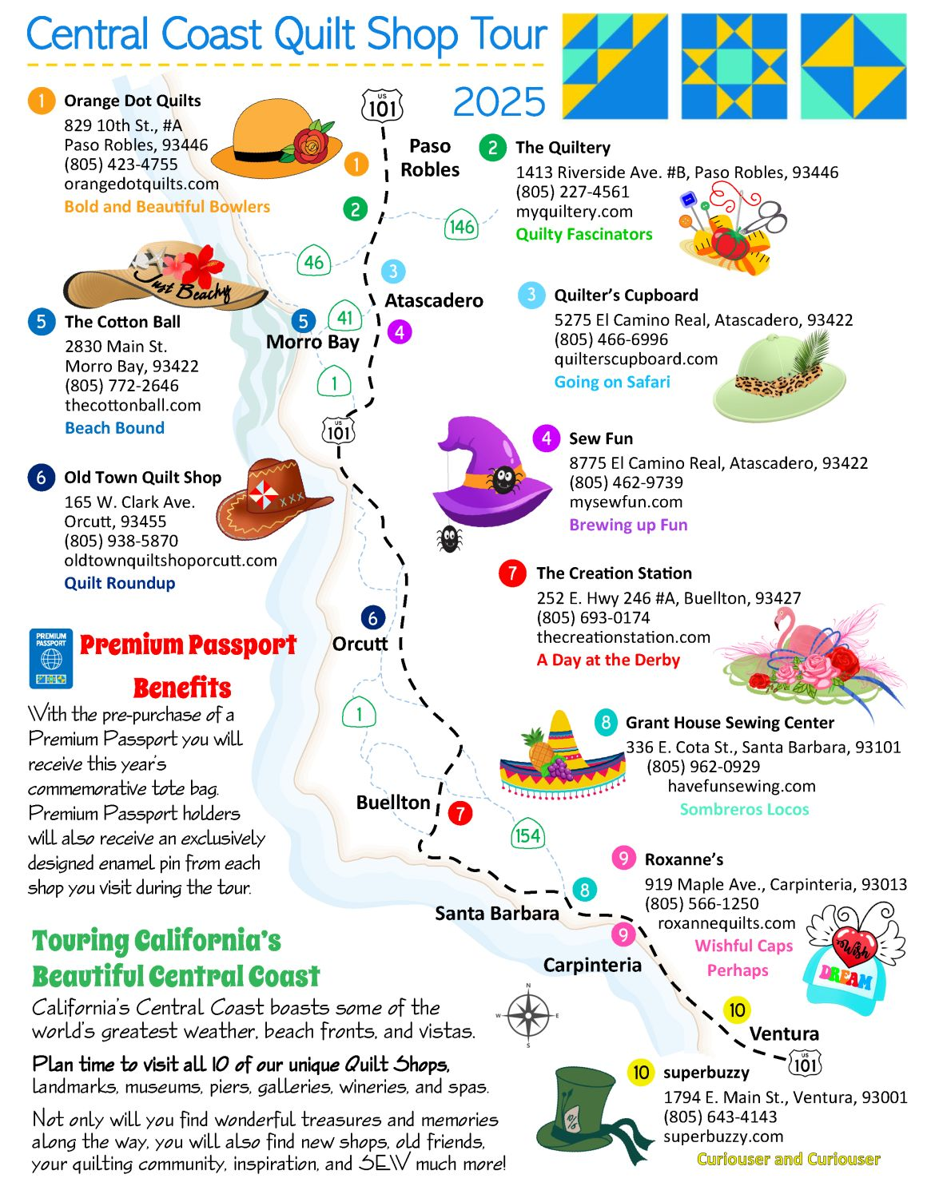
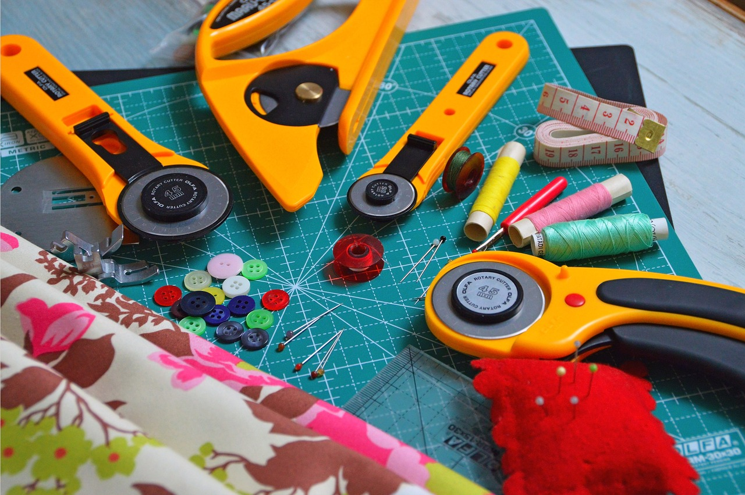
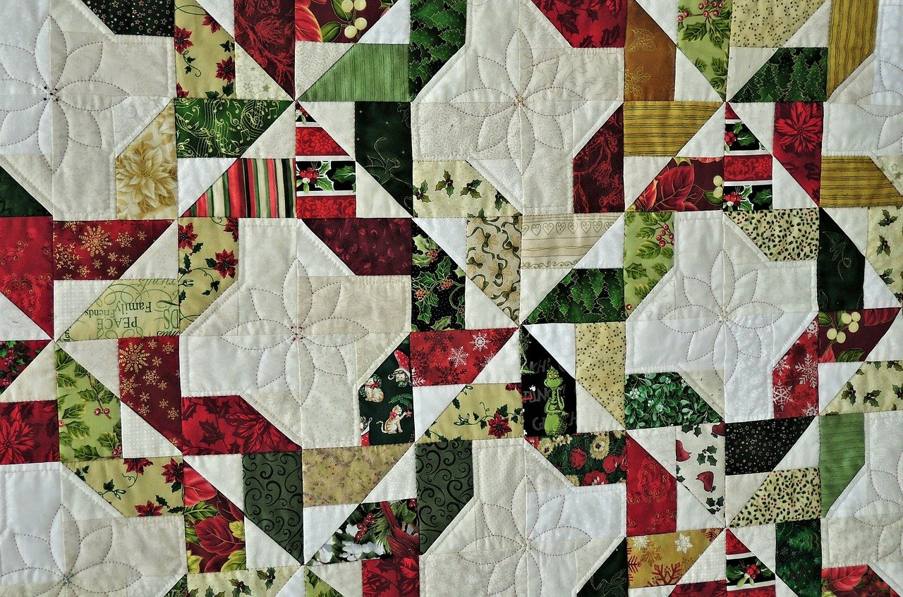
And Don’t Forget – Quilt Shops!
https://quiltshopsofthecentralcoast.com/

Slide 47
So Follow the Yellow Brick Road to the 64th California State Square Dance Convention
www.squaredance.org/convention/2026/

